Slide 1
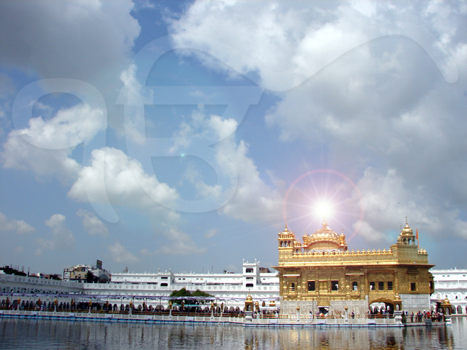
Why No Palki in
Darbar Sahib ?

Slide 2
Why is there no palki for the Parkash of Guru Granth Sahib in Darbar Sahib (Amritsar)?"
He probably had visited Amritsar for the first time.
His words came out of a hurt mind in a tone of a complaint against the SGPC management for their failure to provide palki and thus not showing due regard and respect for Guru Granth Sahib.

Slide 3
Tradition of the use of Palki
In those times kings used high quality horses, elephants or palkis for their ride.
Palki was used to provide the king the comfort and the honor while moving from one place to the other.

Slide 4
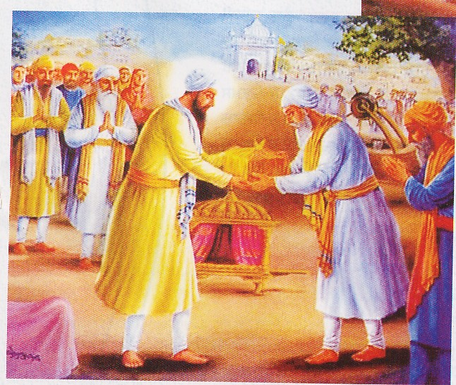
Tradition of the use of Palki
"In the Sikh tradition, we read about the use of the palki for the first time when Guru Arjun Dev brought the sacred four pothis containing Gurus from Gobindwal to Amritsar.”
Baba Mohan ji handing over the pothis to Guru Arjan Dev ji

Slide 5
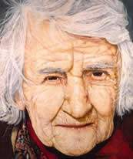
Tradition of the use of Palki
"The king, as a judge does today, held his court while sitting on an open throne fully visible to his audience and not when sitting in a palki.

Slide 6
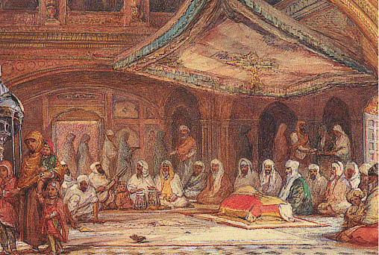
Tradition of the use of Palki
Accordingly, while conducting a diwan, we always install Guru Granth Sahib on a manji (a throne, and not in a palki) with a canopy on the top and accompanied by a Chaur.

Slide 7
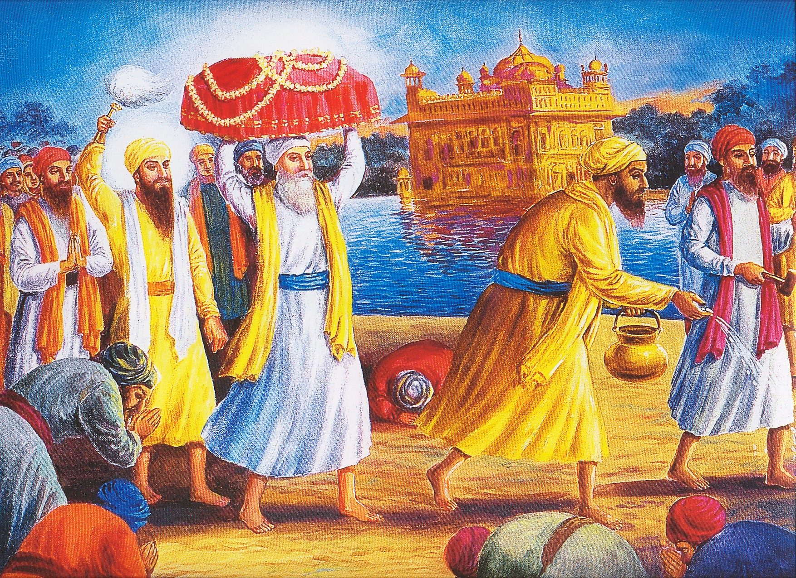
Tradition of the use of Palki
Gurbani is a spiritual eternal Guru, the true king, hence we always adopt full protocol due to a king, whenever a diwan, court of the Guru, is held.

Slide 8
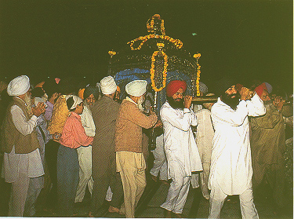
Tradition of the use of Palki
In the same way, palki is also used to bring Guru Granth Sahib back to the Akal Takht at night.
The palki, as during the days of Gurus, is used every day only to carry Guru Granth Sahib from the Akal Takht to Sri Darbar Sahib for the keertan diwan there.

Slide 9
. Gurbani is a spiritual eternal Guru, the true king, hence we always adopt full protocol due to a king, whenever a diwan, court of the Guru, is held.
The palki, as during the days of Gurus, is used every day only to carry Guru Granth Sahib from the Akal Takht to Sri Darbar Sahib for the keertan diwan there.
In the same way, palki is also used to bring Guru Granth Sahib back to the Akal Takht at night."

Slide 10
sangat comes to the gurdwara to listen to gurbani/katha and not to be pleased with decorations and changing lights, the place for which is a living room in a house.
The twinkling electrical lights disturb the concentration of mind, something not desired by any devotee, who attends gurdwara to learn the message of gurbani.

